Slide 1
Ash Winter
Short stuff here:
@northern_tester
Long stuff here:
testingisbelieving.blogspot.co.uk

Slide 2
Improving Testing Through Operability

Slide 3
What do I mean by operability?
How well a software system works when operating live
Minimise time, cost and effort from unplanned interventions

Slide 4
What does good operability look like?
Easy to deploy, test and interrogate
Usable information on state of service
Predictable and non-catastrophic failure modes
Usable for internal stakeholders
Removes toil, increases humane work

Slide 5
Operability and testing
Observability of the unknown
Monitoring of the obvious
Controllability
Risk identification
Discuss failure modes

Slide 6
Operability and testing
Information on performance & capacity
Recoverable & resilient
Less false positives & negatives
Uptime means testing time
And many more

Slide 7
My operability story…
Performance testing?
A new development function
Terraforming environments
New live and test environments
New Jenkins build servers

Slide 8
My operability story…
Network connectivity
Infra test automation
Monitoring & alerting
Log rotation & aggregation
Circuit Breakers
Even VPN…

Slide 9
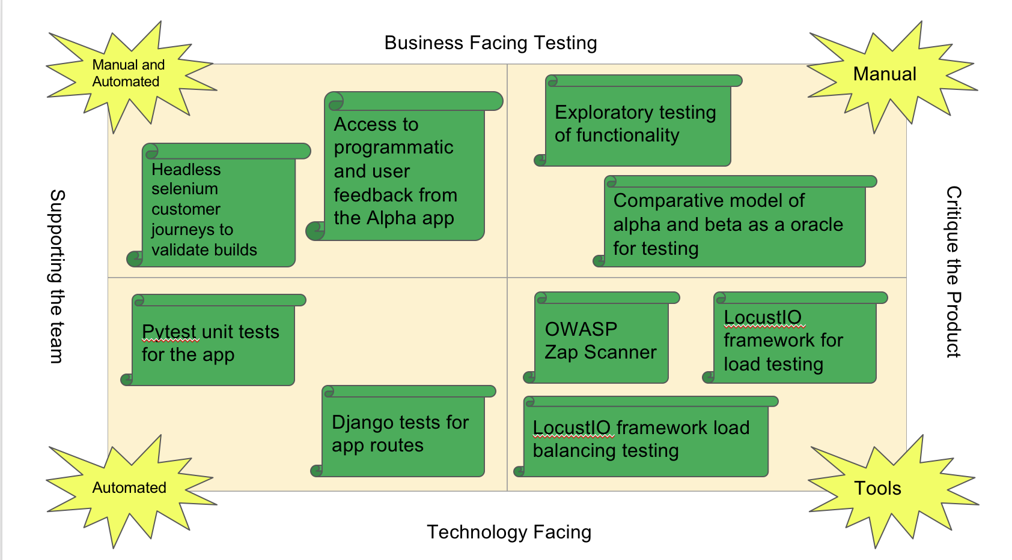
In the end, great, balanced testing!

Slide 10
What’s your story?
Cloud migration?
Re-platforming?
Expanding?
Rewriting?
Replacing entirely?
Or just interested in how operability and testing are linked?

Slide 11

Follow the path…
Runbook – operability test strategy
Logging – simple logging and adding structure for machine readability.
Alert – determining normal with the team and showing the difference.
Hooks – control yourself and your application

Slide 12
Stretch…
Aggregate – bringing logs together
Decompose – techniques for isolating applications

Slide 13

Exercises
Groups
Code Along
Pair if you wish
Help each other
Visible
Questions
Breaks

Slide 14

Begin!

